Slide 1
Investment Decision Recommendation System
BUCKMAN DATATHON
Dhivyadharshini B (21PD06)

Slide 2
Steps followed for obtaining the Best Investment Decision
Data Cleaning:
The Given data is a categorical data and it was analysed and cleaned based on the requirements and usage in the code.
So, the Household income was split into Lower and Upper bounds of their values and the implementation was presented in the code. Then Percentage of investment was splitted based on their lower and upper bounds.

Slide 3
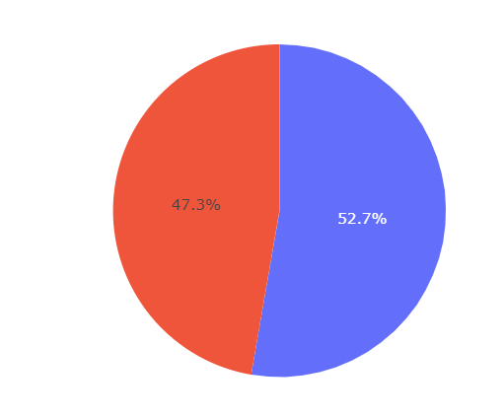
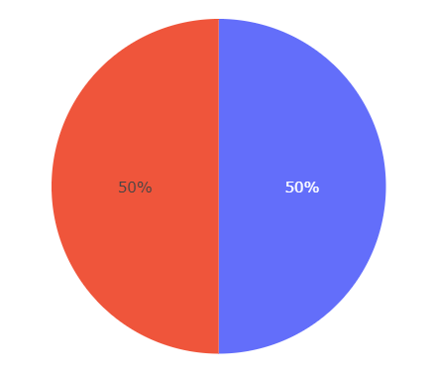
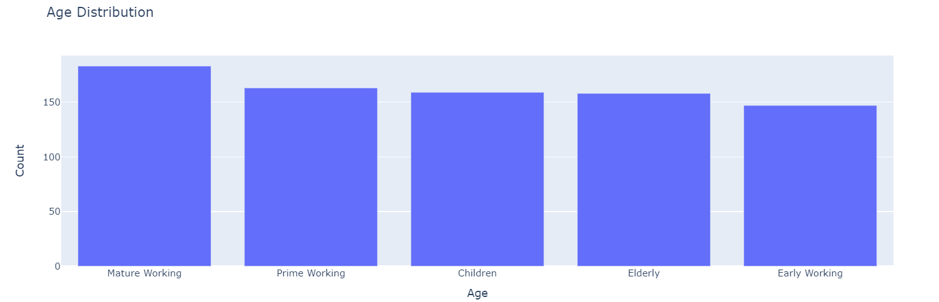
2. Data Exploration
Here the data is taken and was analysed by considering its gender, marital status and age as the demographic features.

Slide 4
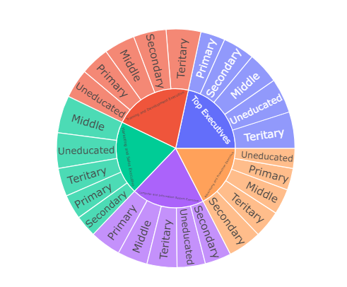
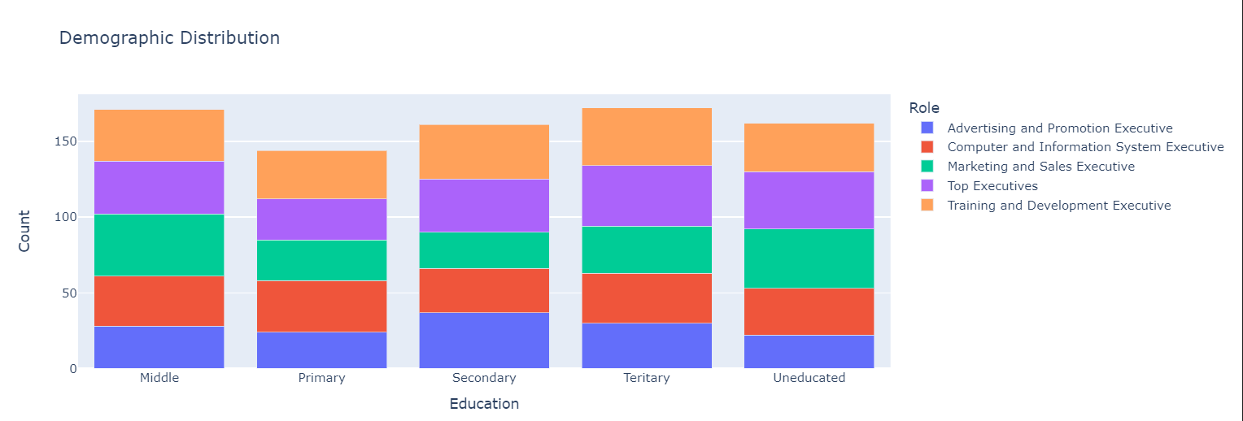
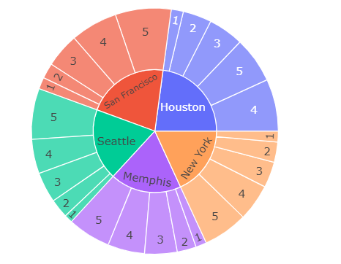
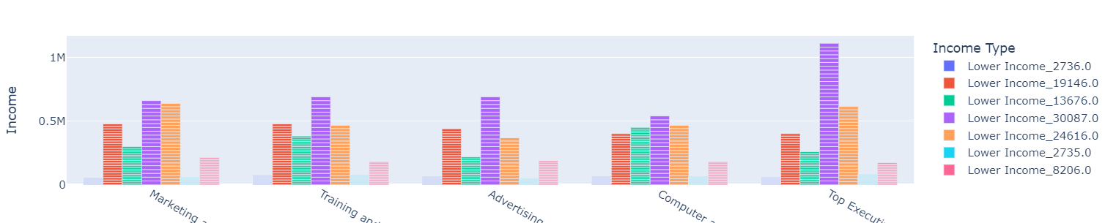
Then the employment details were analysed based on education, role and Household income.

Slide 5
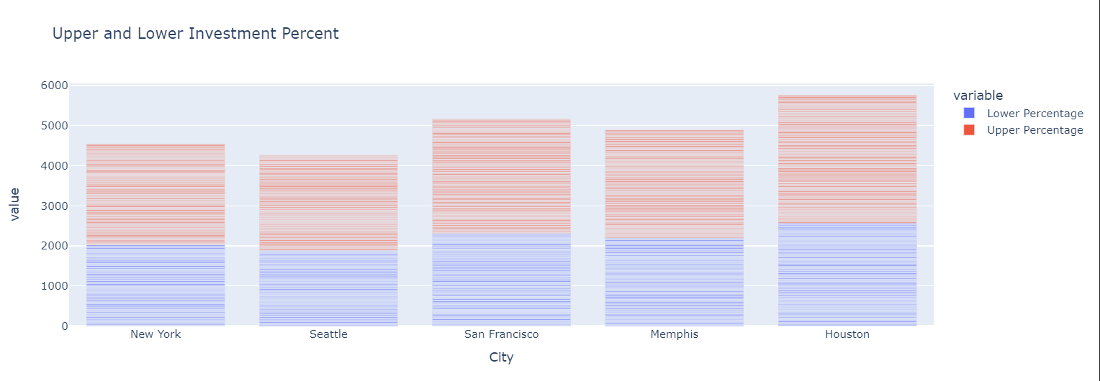
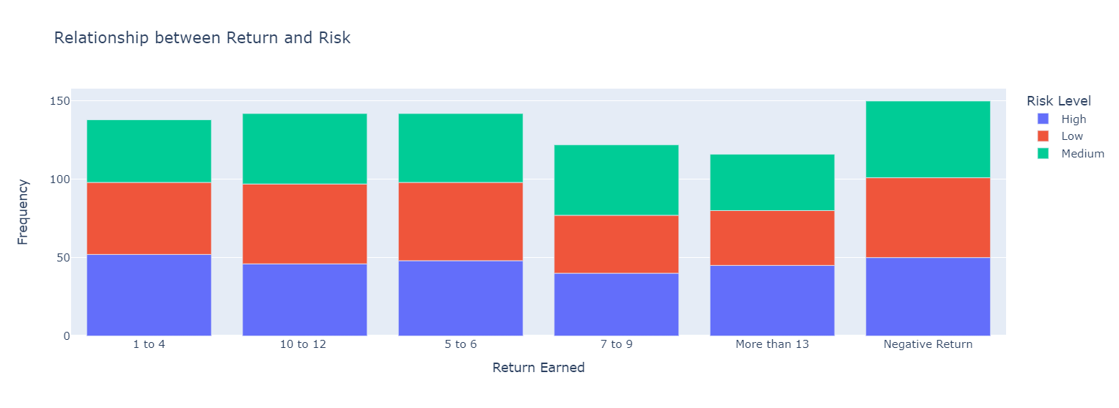
Then the investment behaviour was analysed.

Slide 6
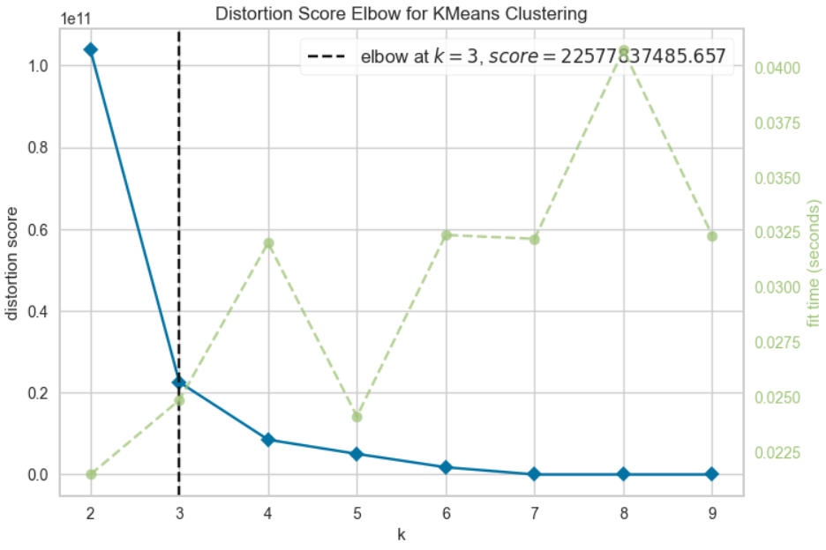
3. Best Investment Decision
The Investment decision was made based on the clusters produced by K-Means Algorithm.
Firstly, all the features were Label encoded.
Secondly, using the elbow plot the optimal value of k is identified.
Then K-Means algorithm was implemented.

Slide 7
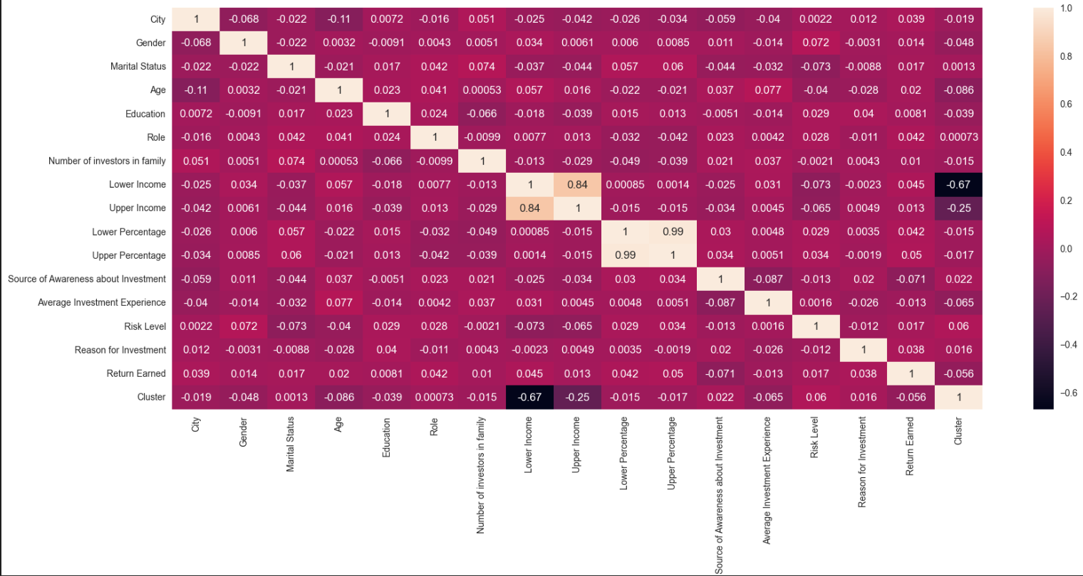
Then the correlation among the features were analysed and it was discovered that the data was not that much correlated.

Slide 8
Then it was analysed that which features will contribute to the best in predicting the model. Methods used were,
Mutual Information Score
Lasso Regularization
Decision Tree classifier
Random forest classifier
For the given data Decision Tree and Random Forest served better than the other two in obtaining the features.

Slide 9
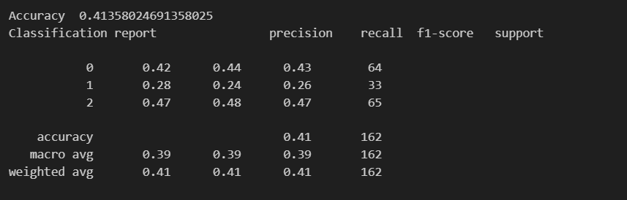
4. Recommendation System Development
The Machine Learning algorithms such as Decision Tree, Random Forest, Support Vector Machine(SVM) and Ridge Classifier were used and their classification reports are as follows,
Decision Tree

Slide 10
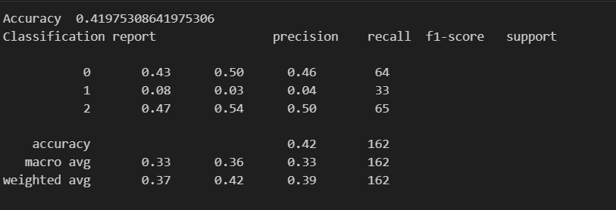
Random Forest

Slide 11

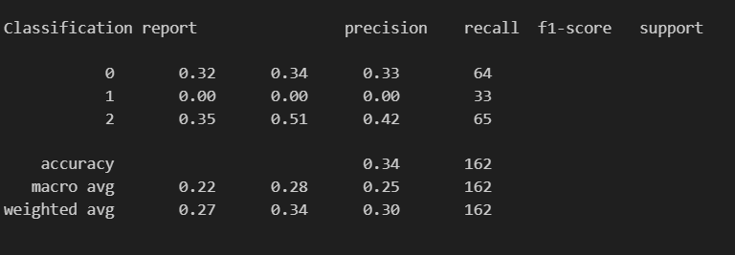

Support vector Machine (SVM)
Ridge classifier

Slide 12
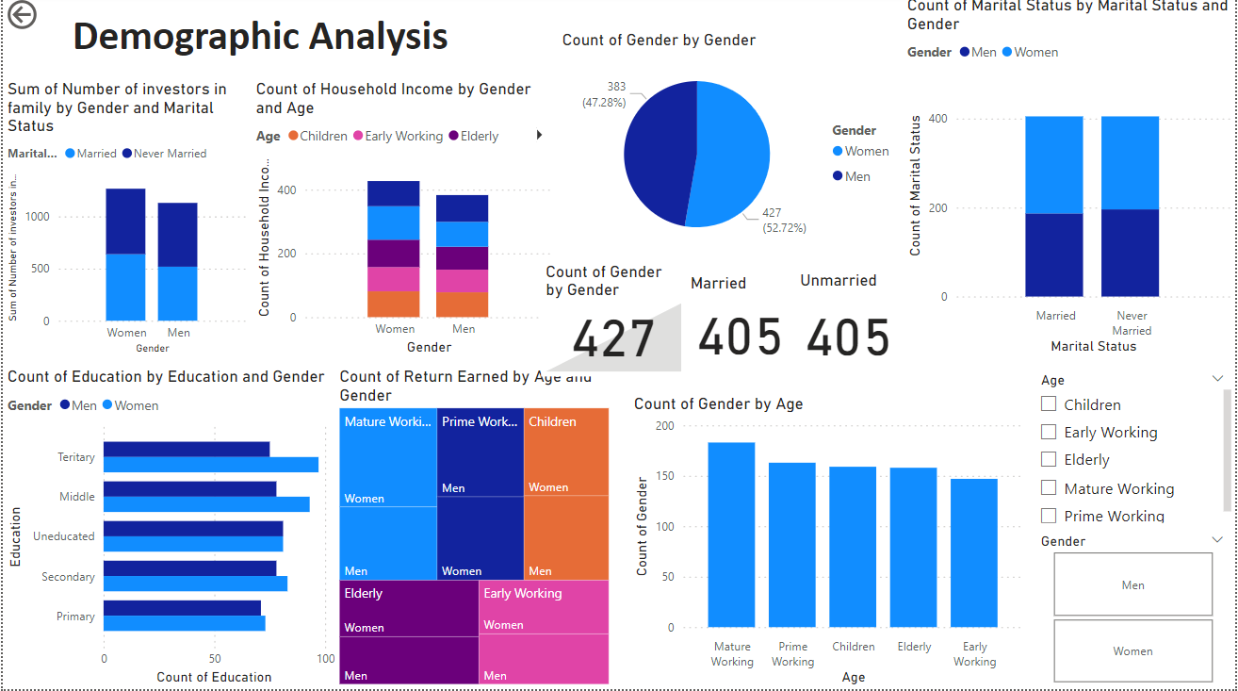
5. Dashboards built using PowerBI

Slide 13
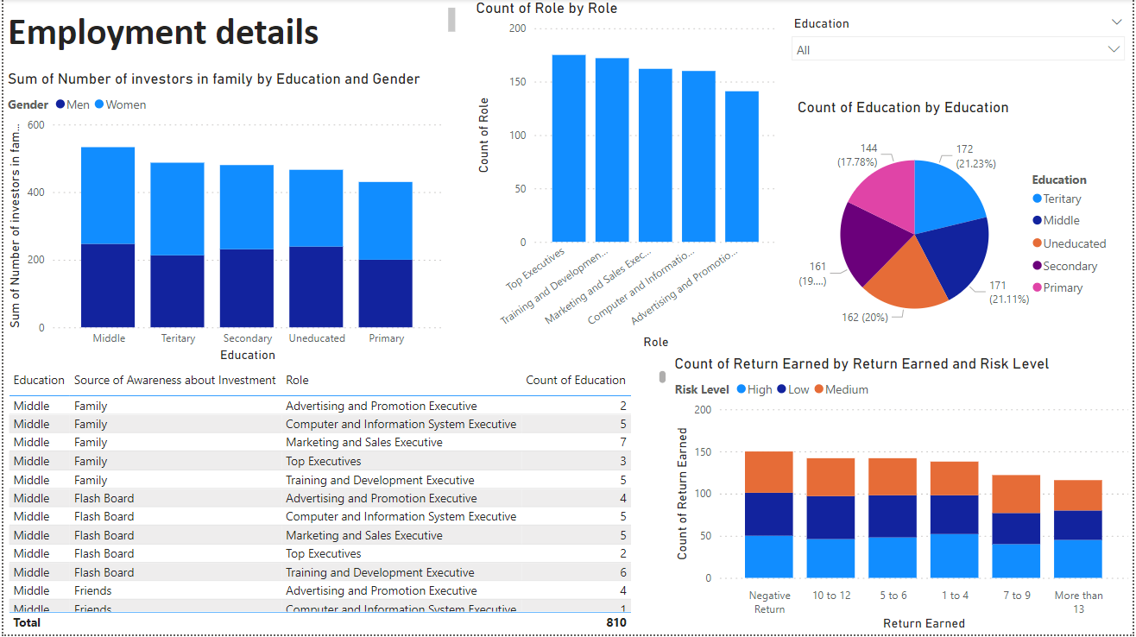

Slide 14
